Slide 1
Data Driven AI
Week 4 - Lecture 1: Feature Engineering
Dr. Abirami Gunasekaran
CHS 2406: Data-driven AI

Slide 2
Feature Engineering
“Feature engineering is the process of transforming raw data into features that better represent the underlying problem to the predictive models, resulting in improved model accuracy on unseen data”. ~Jason Brownlee
“Coming up with features is difficult, time-consuming, requires expert knowledge. ‘Applied machine learning’ is basically feature engineering”. ~ Andrew Ng
“More data beats clever algorithms, but better data beats more data”. ~Peter Norvig
Notes:
the power of ML doesn’t come from the models, it comes from the data, and more specifically, the features.

Slide 3
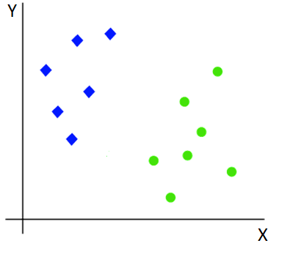
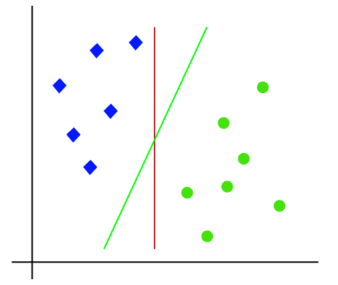
Linear Feature space
Why Feature engineering?
A linear model separates these classes easily

Slide 4
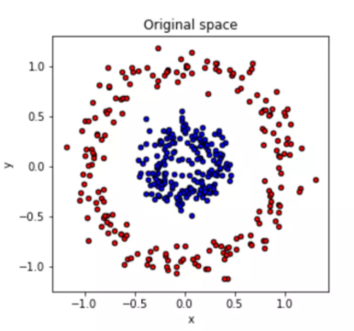
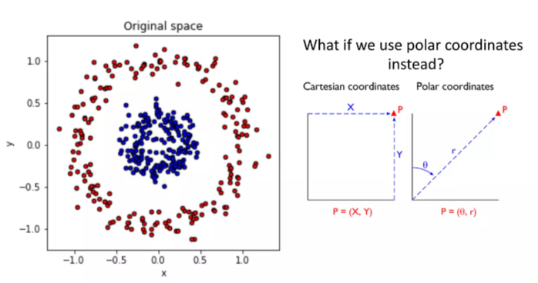
Why Feature engineering?
Not possible for a linear model to separate the classes

Slide 5
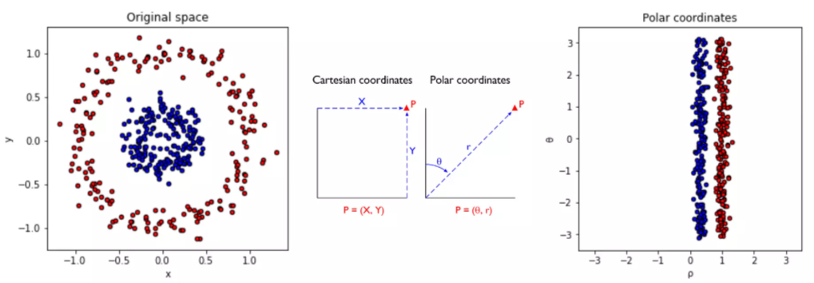

Why Feature engineering?

Slide 6
Feature engineering is hard!!
Powerful feature transformations (like target encoding) can introduce leakage when applied wrong
Usually requires domain knowledge about how features interact with each other
Time-consuming, need to run thousand of experiments
Why Feature Engineering matters
Extract more new gold features, remove irrelevant or noisy features
Simpler models with better results

Slide 7
Feature Engineering
1. Feature Transformation
Feature construction
Transformation techniques
Feature encoding – various encoding types
Binning
Scaling/normalisation
Feature extraction
Grouping
Feature interactions
PCA
2. Feature selection

Slide 8
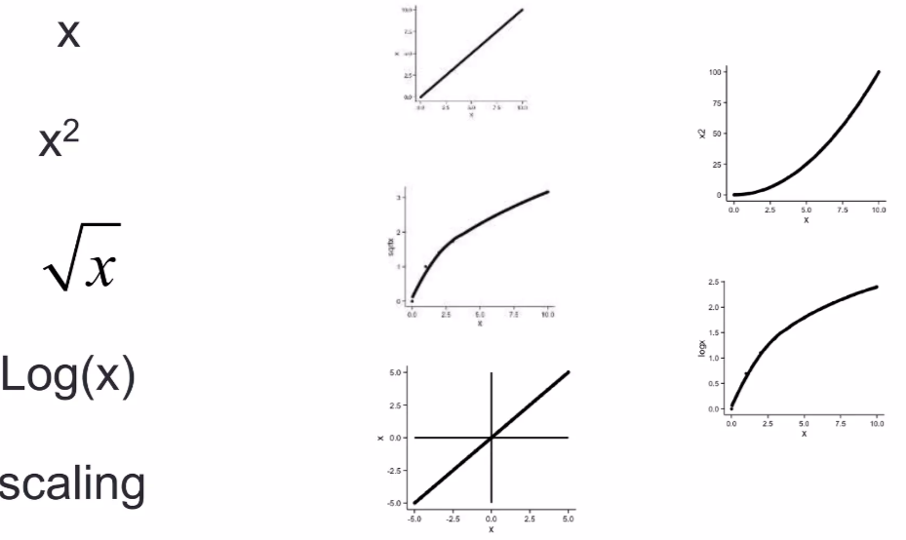
Transformation Techniques
Applied to individual features (variables) in a dataset to make them more suitable for modelling.
Often used to correct skewness, normalise data, or make relationships more linear for better model performance.
Logarithmic Transformation (log(x))
Square Root Transformation (√x)
Reciprocal Transformation (1/x)
Exponential Transformation (e^{x})

Slide 9
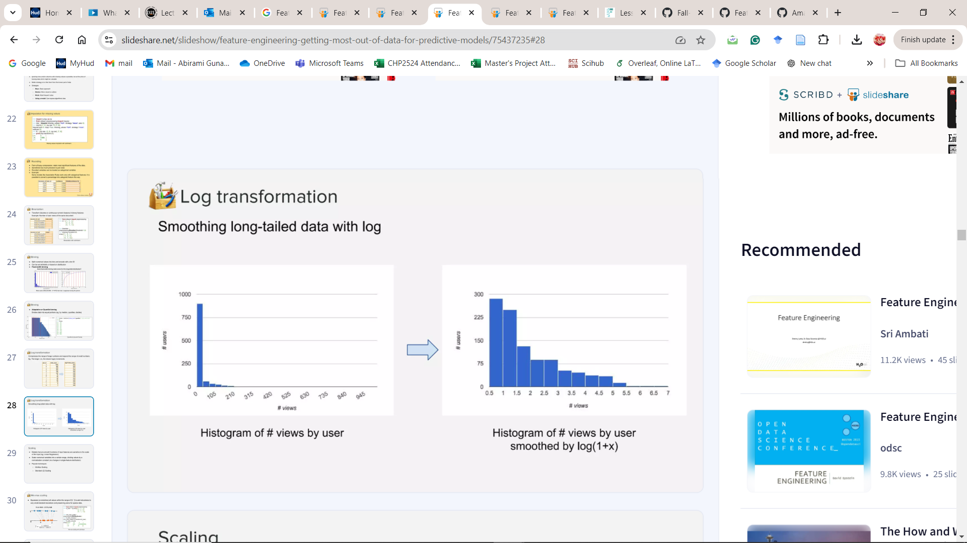
Logarithmic transformation
Compresses the range of large numbers and expand the range of small numbers.
E.g. The larger x is, the slower log(x) increments

Slide 10
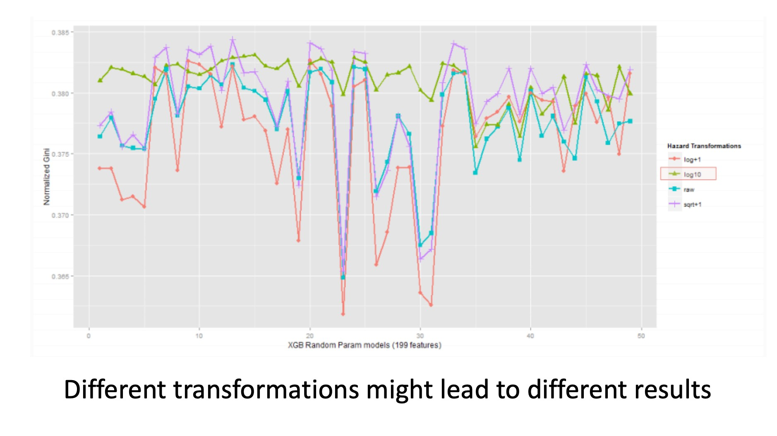
Different transformations might lead to different results

Slide 11
Feature Encoding
Turn categorical features into numerical features to provide more fine-grained information
Help explicitly capture non-linear relationships and interactions between the values of features
Most of machine learning tools only accept numbers as their input
e.g., xgboost, gbm, glmnet, libsvm, liblinear, etc.

Slide 12
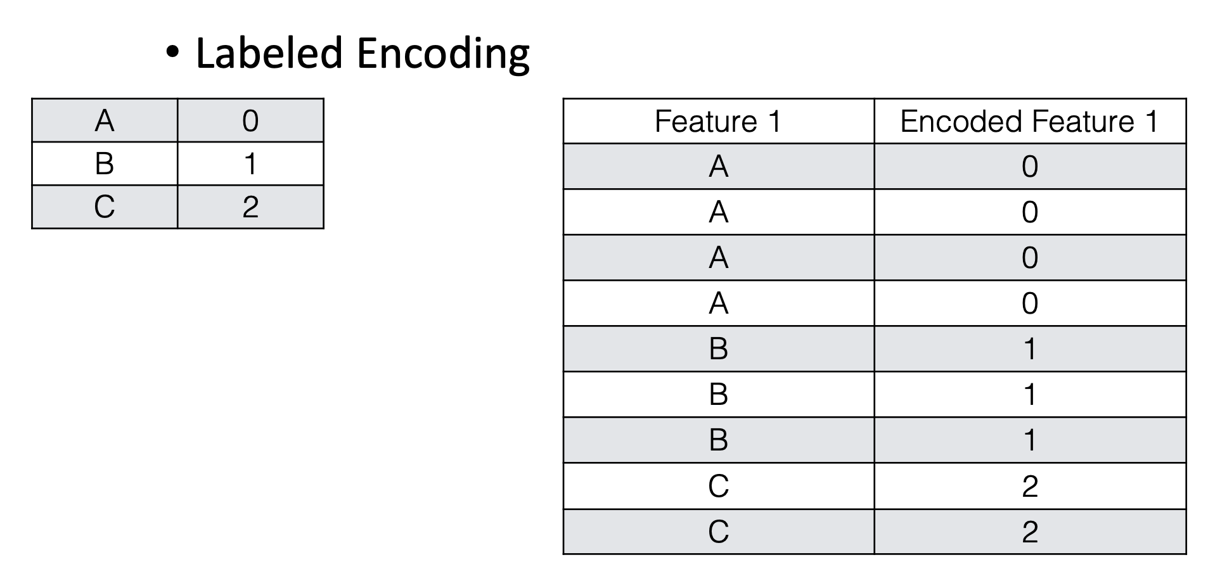
Label Encoding
Interpret the categories as ordered integers (mostly wrong)
Python scikit-learn:
LabelEncoder()
Suitable for tree-based models

Slide 13
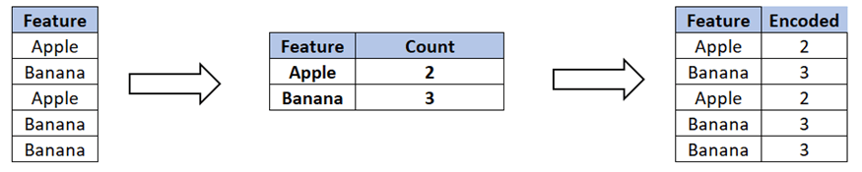
Count Encoding
Replace categorical variables with their count in the train set
Useful for linear and non-linear algorithms
Can be sensitive to outliers

Slide 14
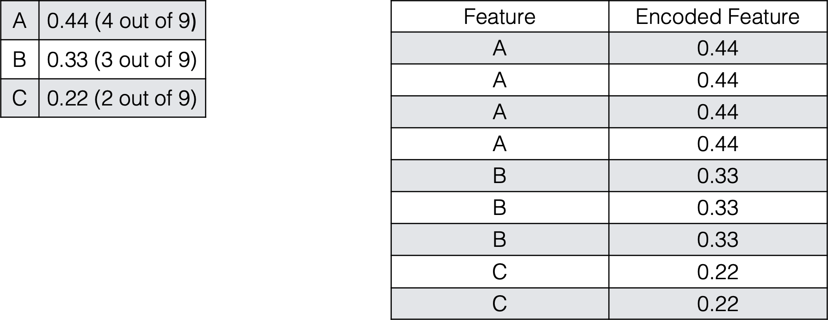
Frequency Encoding
Encoding of categorical levels of feature to values between 0 and 1 based on their relative frequency

Slide 15
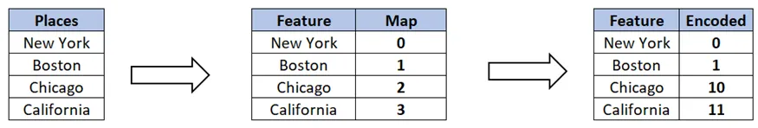
Binary Encoding
In binary encoding, the categories are represented as binary digits.

Slide 16
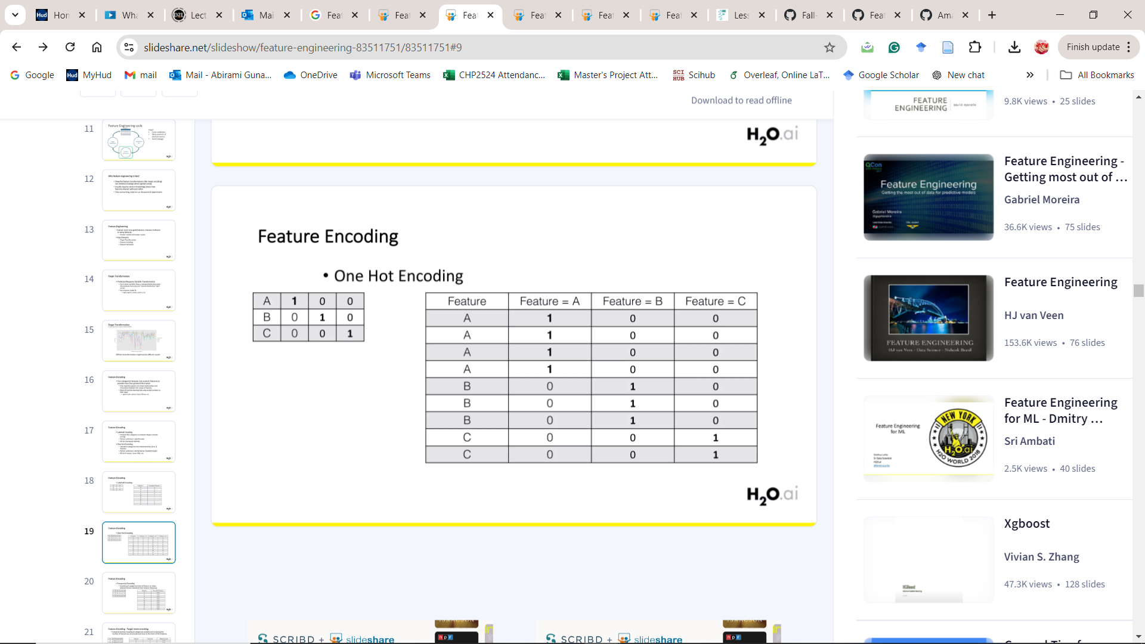
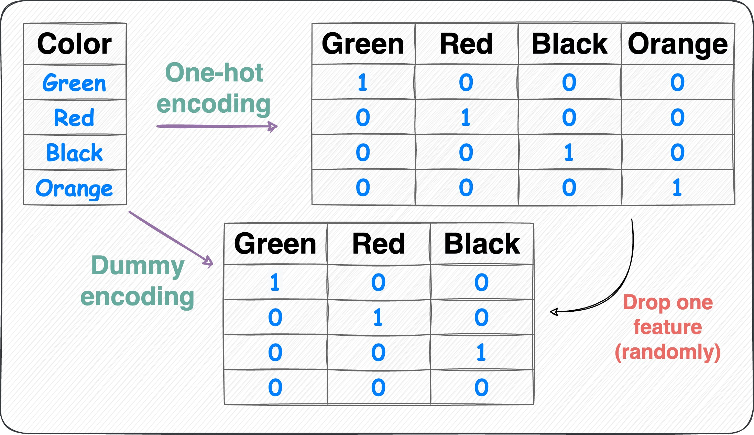
One Hot Encoding
Transform categories into individual binary (0 or 1) features
Python scikit-learn:
DictVectorizer, OneHotEncoder
Suitable for K-means, Linear, NNs, etc.

Slide 17
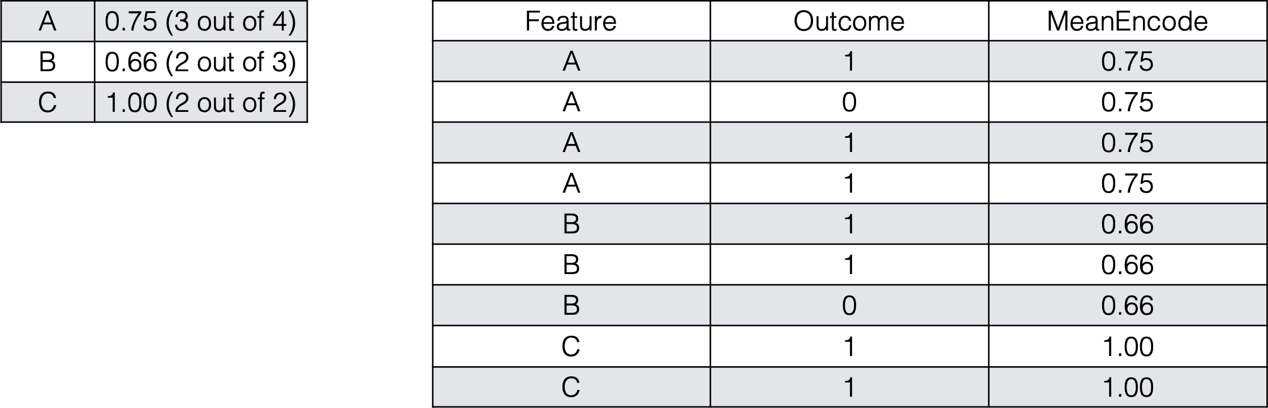
Target Mean Encoding
Instead of dummy encoding of categorical variables and increasing the number of features, we can encode each level as the mean of the response.
Encode by the ratio of target

Slide 18
Binning
Binning can generate new features that capture trends or patterns in the data that might not be obvious when using continuous values.
Improves interpretability
Reduces the impact of Outliers
Deals with non-normal distributions

Slide 19
Equal-Width Binning (Uniform Binning)
Divides the range of the feature into bins of equal width.
Use Case:
When you want to maintain equal intervals regardless of data distribution.
E.g. If you have a feature that ranges from 0 to 100 and you want 5 bins, the bin edges might be [0, 20, 40, 60, 80, 100].
df['binned_feature'] = pd.cut(df['feature'], bins=5)
Equal-Frequency Binning (Quantile Binning)
Divides the feature into bins where each bin contains approximately the same number of data points.
Use Case: When you want to create bins that capture an equal distribution of data points across intervals.
E.g. If you want to split data into quartiles (4 bins), each bin will contain 25% of the data points.
df['quantile_binned_feature'] = pd.qcut(df['feature'], q=4)

Slide 20
Custom Binning (Domain-Specific Binning)
Manually you specify bin edges based on domain knowledge or specific requirements.
Use Case: When you have prior knowledge or want to define meaningful categories
E.g. Grouping ages into categories: children (0-18), young adults (19-35), adults (36-50), seniors (51+).
K-Means Binning
Applies K-means clustering to find the optimal bin edges based on data similarity.
Use Case: When you want to create bins that group data points based on their similarity.
E.g.: You can use scikit-learn’s KMeans to cluster data points and then use the cluster labels as bins.

Slide 21
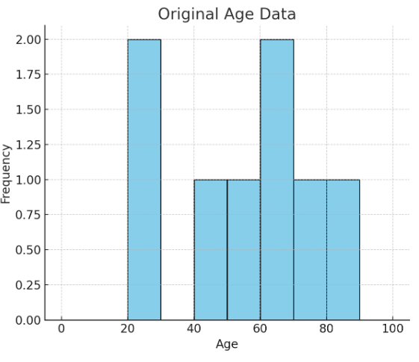
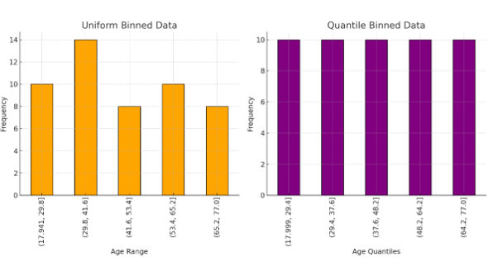
Binning Examples

Slide 22
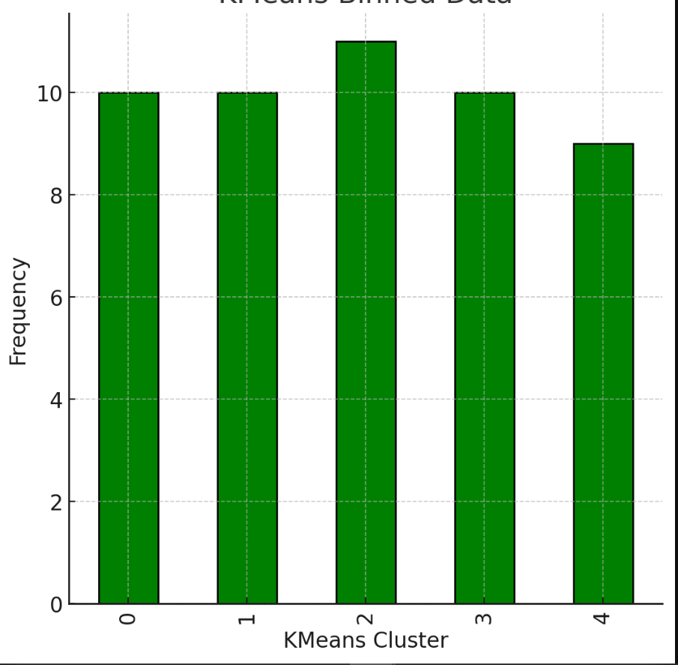
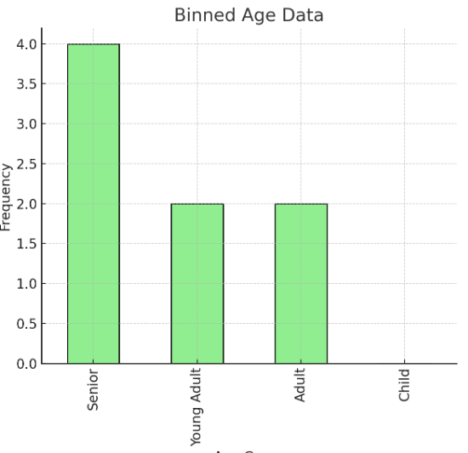
Binning Examples
Custom Binning

Slide 23
Considerations When Binning
Choice of Binning Strategy:
The type of binning (equal-width, equal-frequency, custom) should align with the data characteristics and modeling goals.
Loss of Information:
Binning converts continuous data into discrete intervals, potentially losing some granularity. This is a trade-off between simplicity and data richness.
Number of Bins:
Too many bins may result in overfitting, while too few bins may oversimplify the data. The optimal number of bins depends on the problem and the data.

Slide 24
Feature Extraction
There usually have some meaningful features inside existing features, you need to extract them manually.
Feature interactions (creating new features by combining existing ones)
Condense information from the original features into fewer new features
Techniques like Principal Component Analysis (PCA), Independent Component Analysis (ICA), and Singular Value Decomposition (SVD)

Slide 25
Grouping
Aggregating
summarising data by applying functions like sum, mean, count, min, max, etc., over a group of records, typically based on one or more categorical features.
helps reduce the size of the dataset while preserving important information.
useful for generating summary statistics
Customer | Sales
Alice | 50
Bob | 30
Alice | 70
Bob | 60
Alice | 90
Customer | Sales
Alice | 210
Bob | 90

Slide 26
Grouping
Pivoting
Transforms data from a long format (where each row is an observation) to a wide format (where rows become columns or vice versa).
Reorganises data to provide insights into relationships between variables.
useful for generating features that capture group-based or time-based trends.
Customer | Month | Sales
Alice | Jan | 50
Bob | Jan | 30
Alice | Feb | 70
Bob | Feb | 60
Alice | Mar | 90
Month/ Customer | Feb | Jan | Mar
Alice | 70 | 50 | 90
Bob | 60 | 30 | NaN

Slide 27
Feature Interactions
Feature interactions refer to situations where the relationship between two or more features influences the target variable in ways that individual features alone cannot explain.
Handling feature interactions involves creating new features by combining existing ones to capture these relationships

Slide 28
Feature Interactions
Multiplicative Interaction
Multiply two or more features to create a new feature.
This is useful when the combined effect of two features is more predictive than their individual contributions.
Additive Interaction
Create new features by adding or subtracting values from two or more features.
Polynomial Features
creating new features by raising existing features to a power or by multiplying features together.
This method is particularly useful in capturing non-linear relationships.
Binning Interaction
Combine two binned features to create interaction terms.

Slide 29
Example Feature Interactions
Age | Income
25 | 40,000
45 | 80,000
35 | 60,000
Age | Income | Age_income
25 | 40,000 | 1,000,000
45 | 80,000 | 3,600,000
35 | 60,000 | 2,100,000
Multiplicative Interaction
Bedrooms | Bathrooms
3 | 2
4 | 3
2 | 1
Bedrooms | Bathrooms | Total_rooms
3 | 2 | 5
4 | 3 | 7
2 | 1 | 3
Additive Interaction
Feature1 | Feature2
2 | 3
5 | 1
4 | 2
Feature1 | Feature2 | Feature1*Feature2
2 | 3 | 6
5 | 1 | 5
4 | 2 | 8
Polynomial Interaction

Slide 30
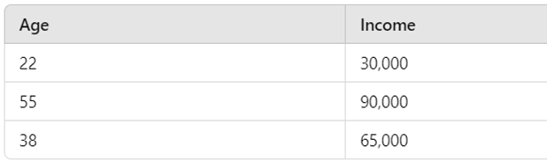
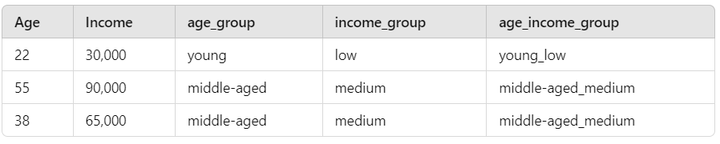
Example Feature Interactions
Binning Interaction
For example, if you bin age into groups (e.g., young, middle-aged, old) and income into low, medium, and high, the combination of these bins might capture more nuanced relationships.

Slide 31
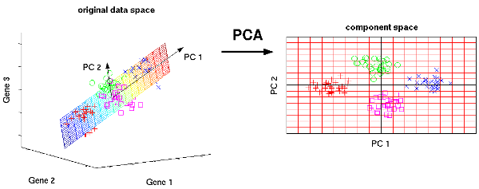
Principal Component Analysis (PCA)
Transforms the original features into a smaller set of uncorrelated components (principal components).
Reduce the dimensionality of data while retaining the most important variance in the dataset.

Slide 32
Any Questions

